Slide 1
Normal Distribution

Slide 2
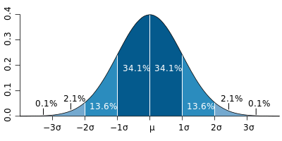
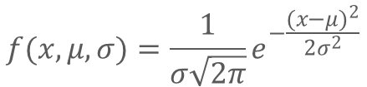

Normal (Gaussian) Distribution
Type of Continuous Probability Distribution
It is bell shaped curve
$μ$ is the mean of distribution
$σ$ is the standard deviation of distribution
𝑃𝑟𝑜𝑏𝑎𝑏𝑖𝑙𝑖𝑡𝑦 𝐷𝑒𝑛𝑠𝑖𝑡𝑦 𝐹𝑢𝑛𝑐𝑡𝑖𝑜𝑛
Shaded area gives the probability that X is between the corresponding values
$$f(x,μ,σ)=\frac{1}{σ\sqrt{2π}}e^{−\frac{{(x−μ)}^{2}}{2σ^{2}}}$$

Slide 3
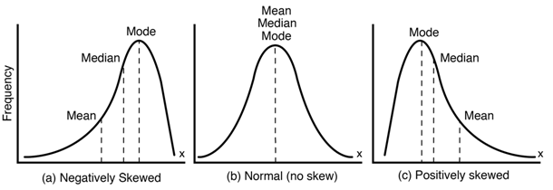
Normal (Gaussian) Distribution
Ideal Normal Distribution curve
Mean = Median = Mode = 0
Zero Skew

Slide 4
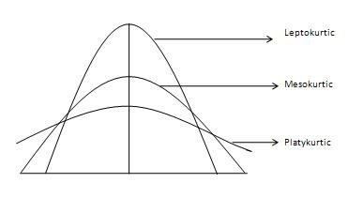
Normal (Gaussian) Distribution
Ideal Normal Distribution curve
A standard normal distribution has
kurtosis of 3 and is recognized as
Mesokurtic
some sources use kurtosis
(often referred to as "excess kurtosis") which is equal to kurtosis-3 to
make ideal kurtosis as zero
Notes:
https://www.sciencedirect.com/topics/neuroscience/kurtosis
https://www.itl.nist.gov/div898/handbook/eda/section3/eda35b.htm

Slide 5
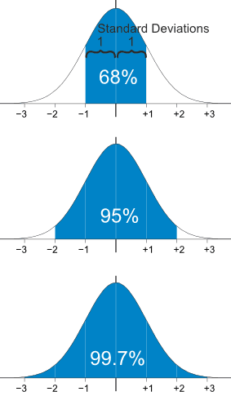
Normal (Gaussian) Distribution
Ideal Normal Distribution curve
68 – 95 – 99.7 empirical rule
(Derived by Chebyshev’s theorem )
Notes:
https://www.sciencedirect.com/topics/neuroscience/kurtosis
https://www.itl.nist.gov/div898/handbook/eda/section3/eda35b.htm

Slide 6
Application
A company produces a lightweight valve that is specified to weigh 1500g, but there are imperfections in the process. Products follow a normal distribution curve. While the mean weight is 1500g, the standard deviation is 300g.
Q1. What is the range of weights within which 95% of the valves will fall?
Q2. Approximately 16% of the weights will be more than what value?
Q3. Approximately 0.15% of the weights will be less than what value?

Slide 7
Application
$$μ=1500$$
$$σ=300$$
Q1. What is the range of weights within which 95% of the valves will fall?
900 to 2100
Q2. Approximately 16% of the weights will be more than what value?
More than 1800
Q3. Approximately 0.15% of the weights will be less than what value?
Less than 600

Slide 8
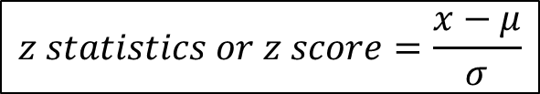
Application
Standardization
When a frequency distribution is normally distributed but non- ideal i.e. $μ$ is not 0 Or $σ$ is not 1 , we can find out the probability of a score occurring by standardising the scores.
$$z statistics or z score=\frac{x−μ}{σ}$$

Slide 9
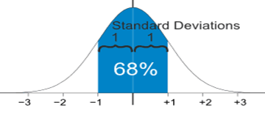
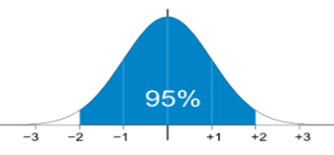
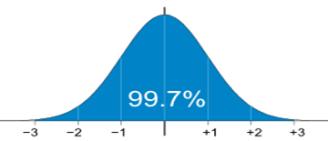
Application
A company produces a lightweight valve that is specified to weigh 1500g, but there are imperfections in the process. Products follow a normal distribution curve. While the mean weight is 1500g, the standard deviation is 300g.

Slide 10
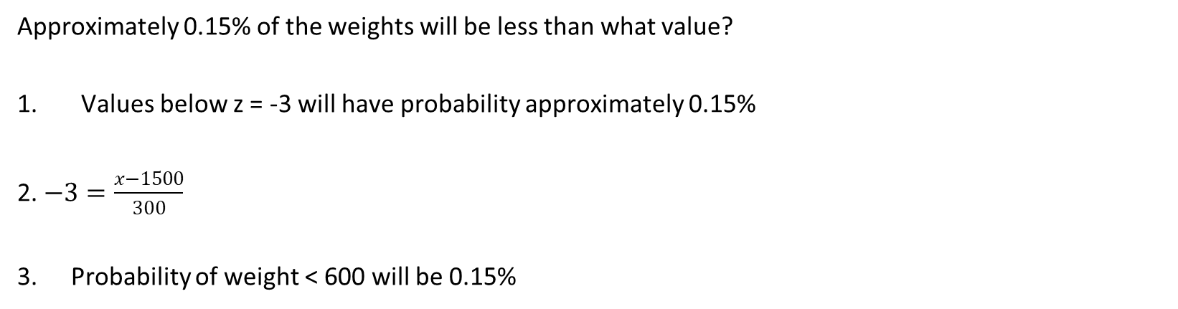
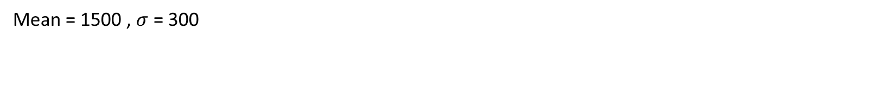
Application
Mean = 1500 , $σ$ = 300
Approximately 0.15% of the weights will be less than what value?
Values below z = -3 will have probability approximately 0.15%
2. $−3=\frac{x−1500}{300}$
Probability of weight < 600 will be 0.15%

